Slide 1









INTRODUCTION
Newsletter

Slide 2




What we have made???
1.Candy game
3.CAR GAME
Click on the "Canva" button under this presentation preview. Start editing your presentation. You need to sign in to your Canva account.
2. STONE PAPER SCISSOR GAME

Slide 3






TABLE OF
CONTENTS
Why we made this game
Logic used
Elaborate on what you want to discuss.
Elaborate on what you want to discuss.
How we mde this game
Elaborate on what you want to discuss.

Slide 4





Introduction to candy game
Elaborate on what
you want to discuss.

Slide 5



TOOLS USED IN MAKING GAME

Slide 6

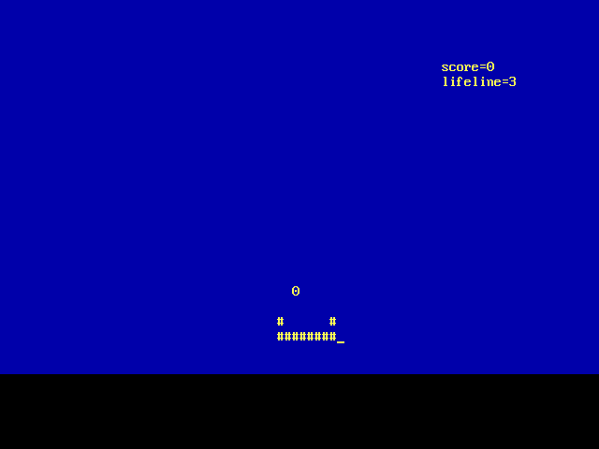




Slide 7
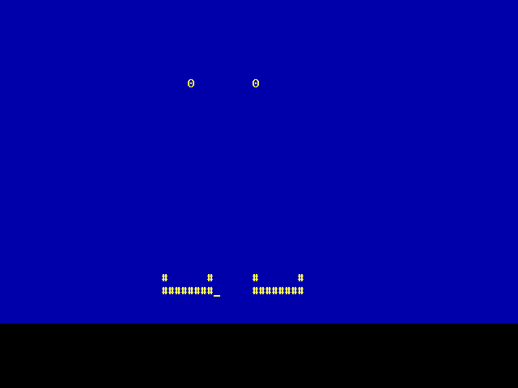


ADD A TIMELINE PAGE
2021
2022
2023
Add a
main point
Add a
main point
Add a
main point
Briefly elaborate on what you
want to discuss.
Briefly elaborate on what you
want to discuss.
Briefly elaborate on what you
want to discuss.

Slide 8


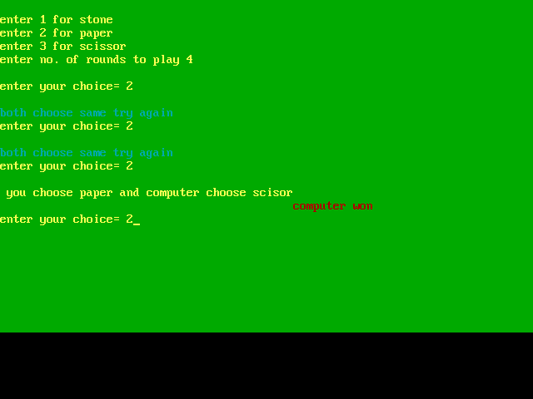



Slide 9

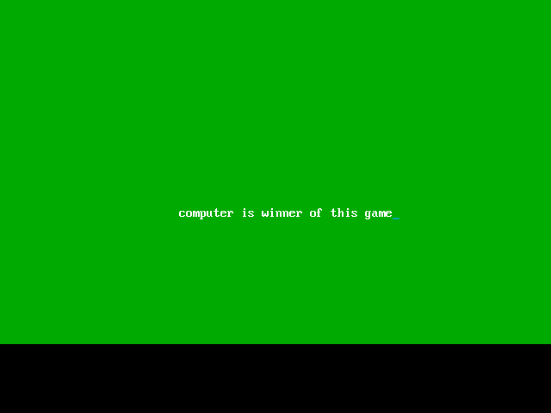


OUR SERVICES
Service One
Service Two
Elaborate on what you want to discuss.
Elaborate on what you want to discuss.
Service Three
Service Four
Elaborate on what you want to discuss.
Elaborate on what you want to discuss.

Slide 10
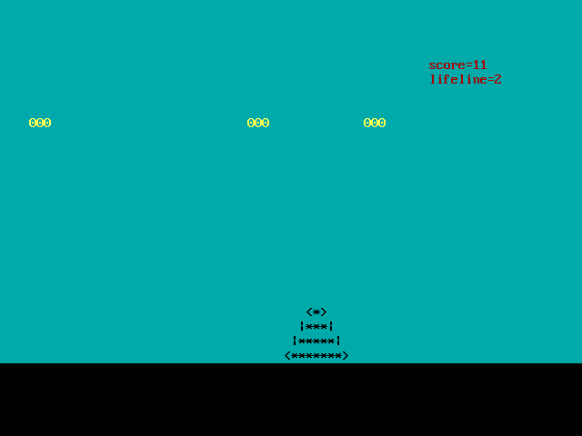








Slide 11




demo

Slide 12




THIS SHOW WHY AND HOW A CODE CAN BE USED IN REAL LIFE , AND WE AREJUST DOING ADDITION OF TWO NUMBERS AND PRINTING HELLO WORLD ON SCREEN
— INCLUDE A CREDIT, CITATION, OR SUPPORTING MESSAGE

Slide 13










